Slide 1


DESIGN 1
Lesson 1: How the Web Connects: The Anchor Tag
Ms. Abboud • Grade 9 - Design 1 • Term 1, Week 5

Slide 2
Learning Objectives
WALT - We Are Learning To
WILF - What I'm Looking For
Explain how hyperlinks connect webpages.
Create working links using the anchor tag.
I can explain what the href attribute does.
I can tell the difference between an absolute and a relative link.

Slide 3
Academic Vocabulary
Hyperlink
Anchor Tag
Clickable text or an image that takes the user to another webpage or location when clicked.
The <a> tag: the HTML element used to create a hyperlink.
href
Absolute Link
The attribute inside an anchor tag that holds the destination address the link points to.
A link using the full web address of a page (e.g. https://www.wikipedia.org), usually pointing to another website.
Relative Link
A link using just a filename or short path (e.g. about.html) to point to another page within the same project.

Slide 4
Frayer Model: Absolute Link
DEFINITION
CHARACTERISTICS
A link using the full web address of a page (e.g. https://www.wikipedia.org), usually pointing to another website.
Full web address; starts with https://; usually points elsewhere.
ABSOLUTE LINK
EXAMPLES
NON-EXAMPLES
href="https://www.wikipedia.org"
href="about.html" (a relative link)

Slide 5
Frayer Model: Relative Link
DEFINITION
CHARACTERISTICS
A link using just a filename or short path (e.g. about.html) to point to another page within the same project.
Just a filename/path; no https://; points within the same project.
RELATIVE LINK
EXAMPLES
NON-EXAMPLES
href="about.html"
href="https://www.wikipedia.org" (an absolute link)

Slide 6
National Identity Integration
UAE Government Digital Services: portals like u.ae link hundreds of government services together. Every service page is connected by hyperlinks, a real example of the web as a network of linked documents.

Slide 7
STARTER
What Happens When You Click?
What actually happens when you click a link?
Make a guess with your partner before we explain it.
Hook • Engage & Ask
5 - 10 minutes

Slide 8
LESSON CORE
I Do: How Links Work
The web is a network of linked documents. The <a> tag with an href attribute creates a clickable link.
Watch: a link to an outside website, then a link to about.html in our own project.
Gradual Release of Responsibility
30 - 40 minutes
Example: an absolute link and a relative link
<!-- absolute: another website -->
<a href="https://www.wikipedia.org" target="_blank">Wikipedia</a>
<!-- relative: a page in my project -->
<a href="about.html">About Me</a>
1 / 3

Slide 9
LESSON CORE
We Do: Notes and Frayer Model
Record the anchor tag syntax in your notes.
target="_blank" opens a new tab: useful for outside sites, not for your own pages.
In pairs: complete a Frayer Model for Absolute Link and Relative Link side by side.
Gradual Release of Responsibility
30 - 40 minutes
2 / 3

Slide 10
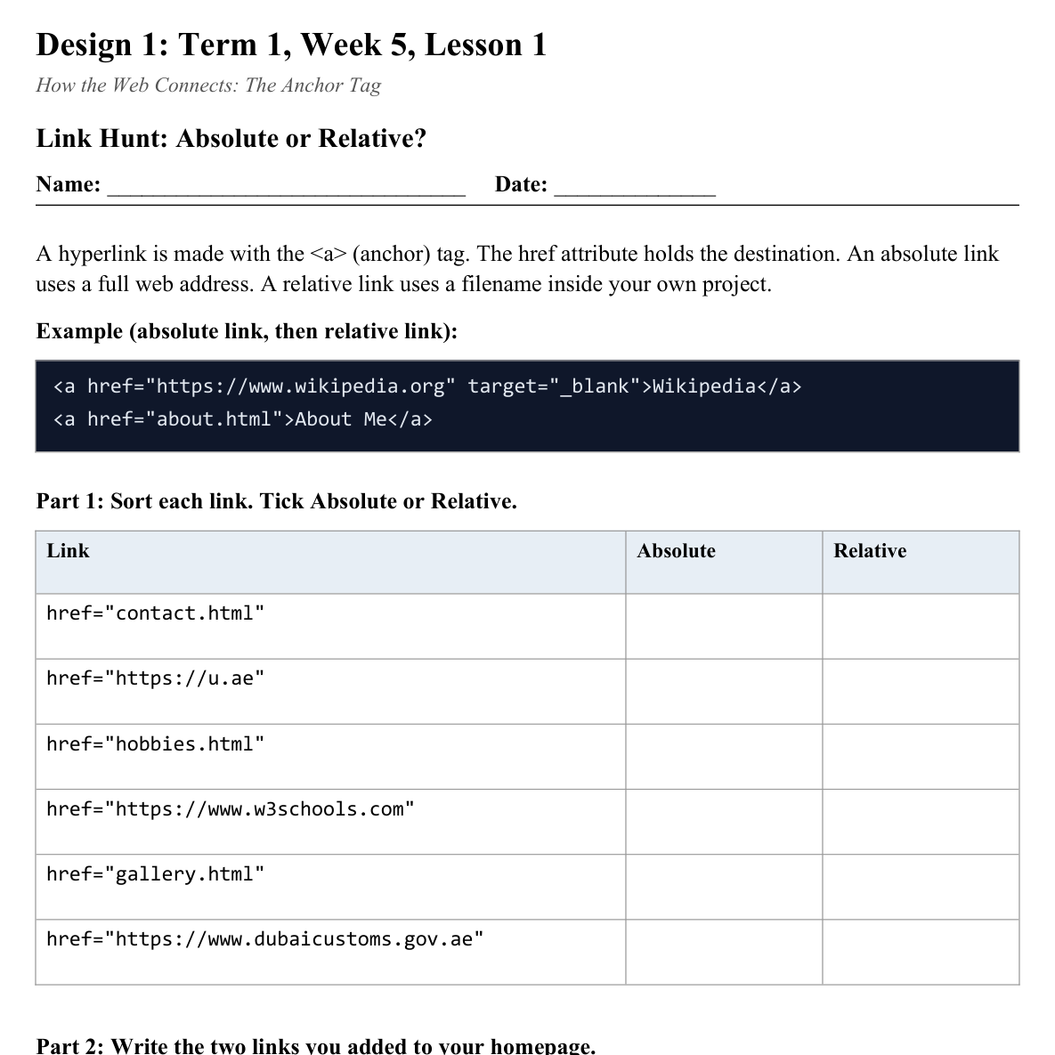
LESSON CORE
You Do: Link Hunt
Sort the links on the Link Hunt sheet, then add one absolute and one relative link to your homepage.
No about.html yet? Create it now.
Activity: Link Hunt, Absolute or Relative?
Gradual Release of Responsibility
30 - 40 minutes
3 / 3

Slide 11
CLOSURE
Exit Ticket
Why might you NOT want every link on your own site to open in a new tab?
Transition & Extend
5 - 10 minutes

